Slide 1
Mlops project overview with mlflow and cloud agnostic deployment architecture (ISAAC) to achieve google level -2 Architecture
Agenda
Mlflow
  a. Training pipeline overview
    Training data from bucket /data base
    Training data from feature store
    Attached mlops Jira stories and project document
b. Data version tool like dvc /delta lake
Research environment
2.Refrence CI/CD/CT pipelines
3. Planned Architecture
4.Testing Overview
  Unit testing
  Integration testing
  Differential testing
  Load testing
5. Deployment Strategies
6. Jenkins pipeline overview
7. CI/CD/CT with ISAAC Deployment
  Performance monitoring
  Statistical monitoring
  Outlier
  Drift
  Explain ability
Production/Staging
environment

Slide 2
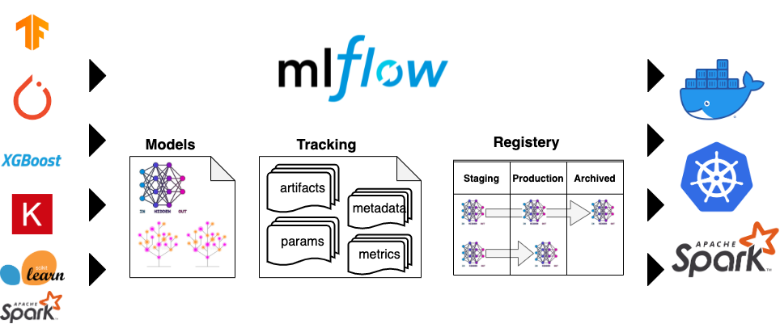
Mlflow : A platform for the machine learning lifecycle

Slide 3

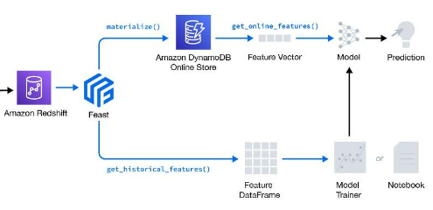
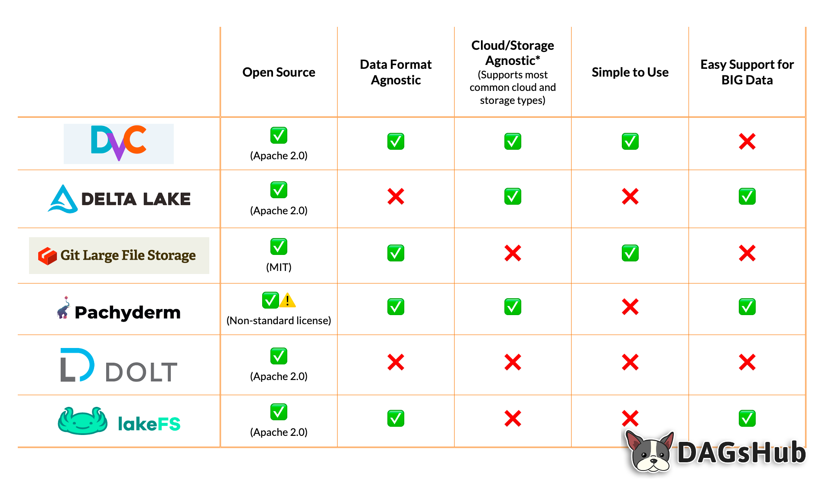

Training Data pipeline overview
Document contains project details feature source , format as well as model details
Should be agreed among stack holders
Mlflow with Data version tools
Mlops epic ,stories, Task for Jira
Optional
1
Model Artifacts
Training dataset
0
Clean
data
Raw source
Filter
data
Storage
Bucket
Bucket
Pull/copy data
Could be trained on gpu or Kubernetes instance as and when required.
MySQL/
Postgres
Testing dataset
Data Engineer/ETL
GCP/AWS/AZURE Storage
Data Scientist

Slide 4
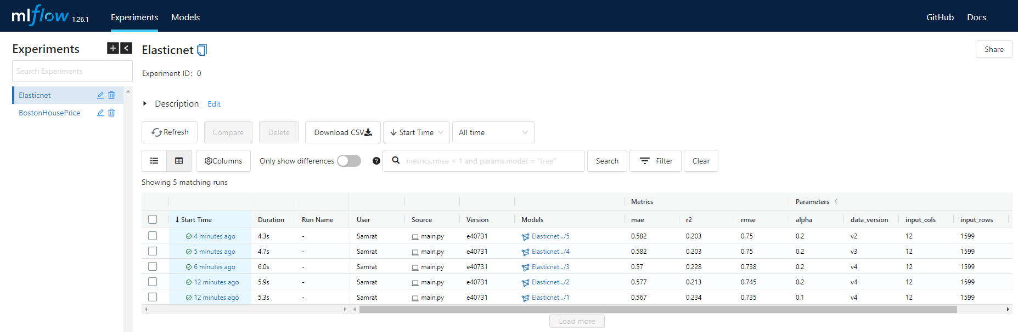
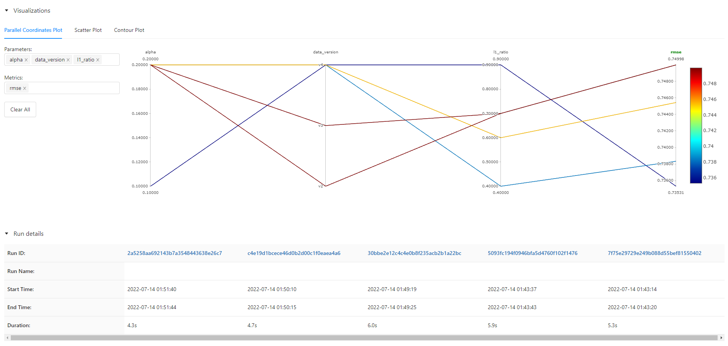
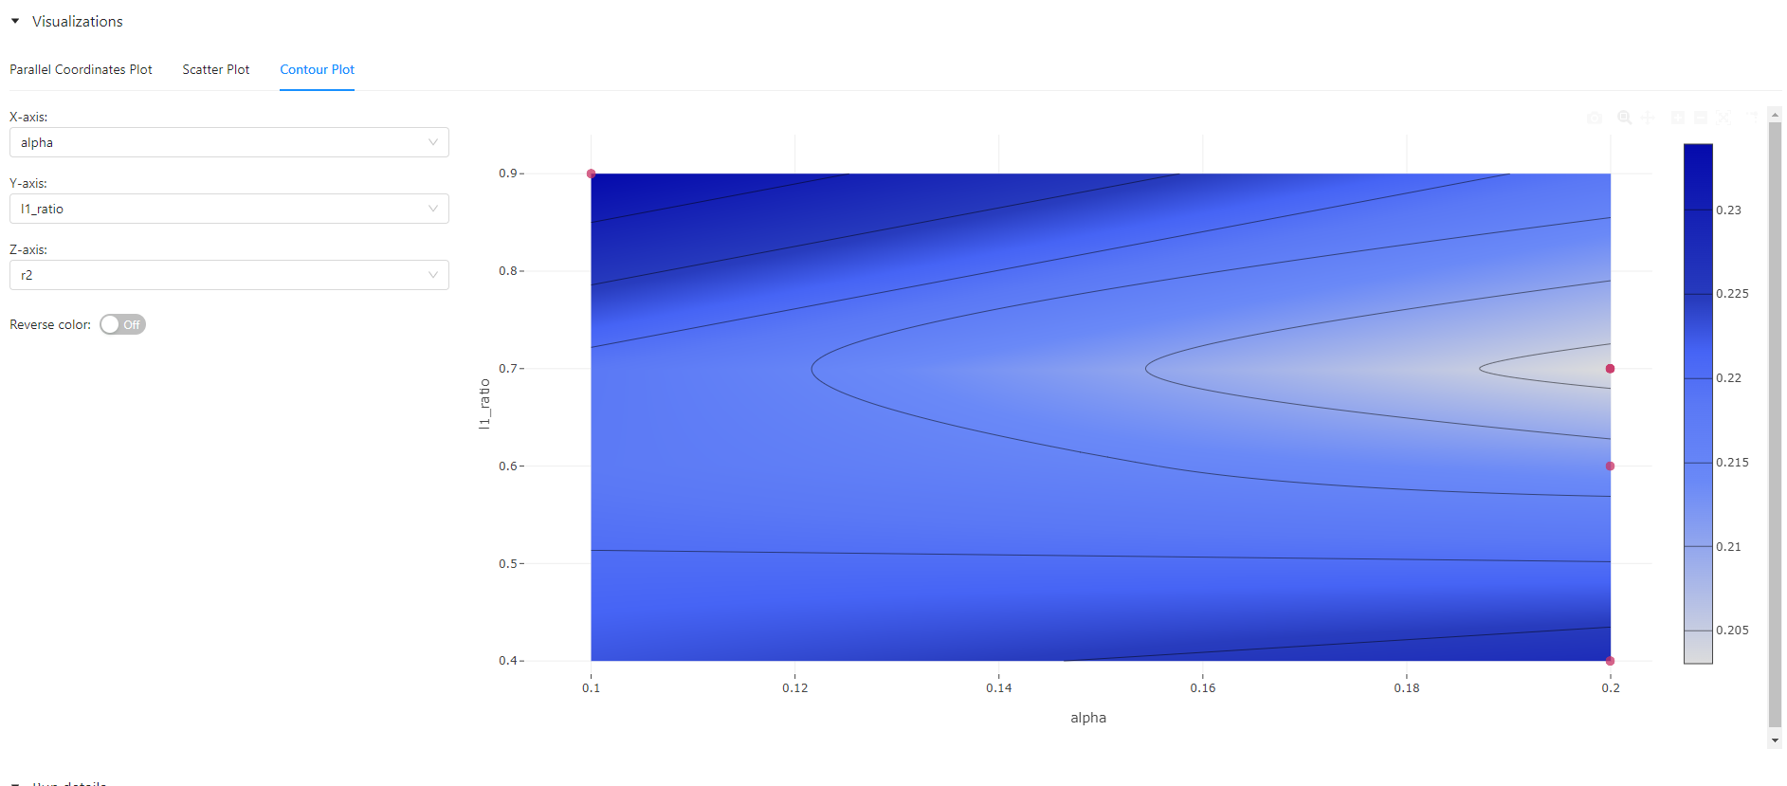
Mlflow in action
Track Experiments
Query model
Metric
Parameter
Data version
Data shape
Track :User,
File Source
Compare Models with different Unique RunID

Slide 5
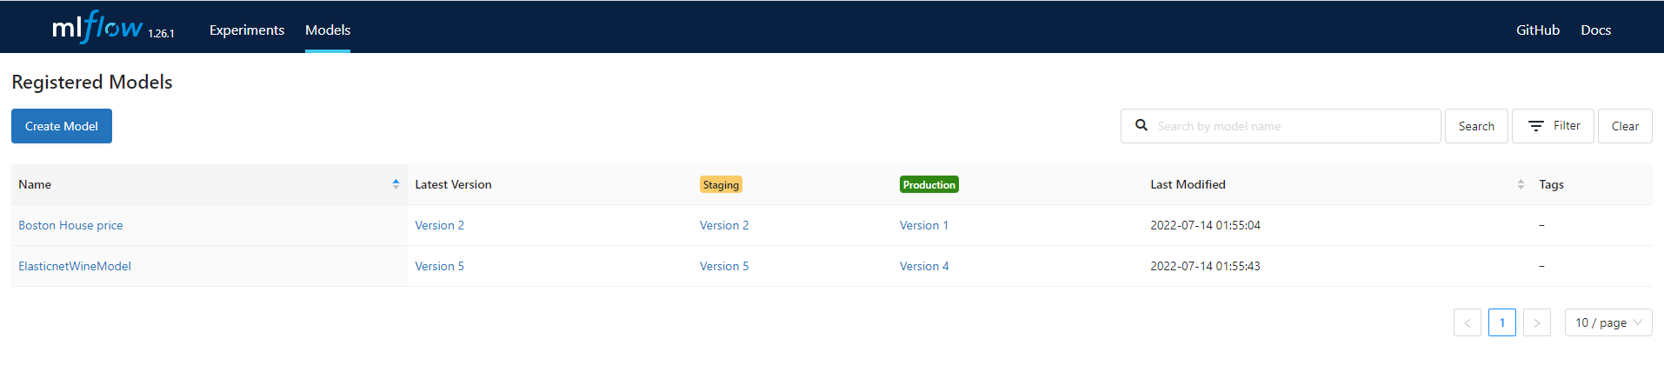
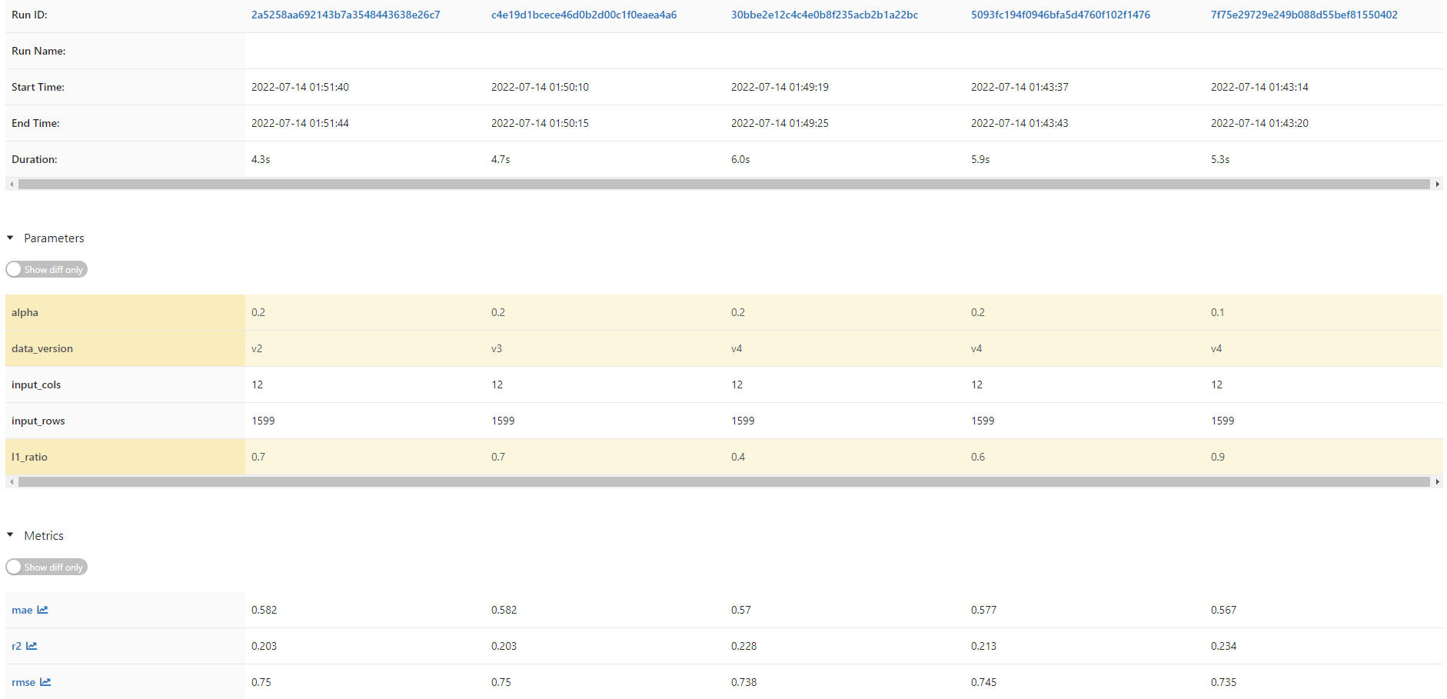
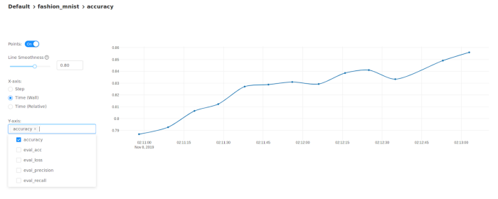
Mlflow in action
Track Model version in Production and staging with limited access control
Compare model with RunID , Parameters and metrics
Accuracy visualization in Keras model.

Slide 6
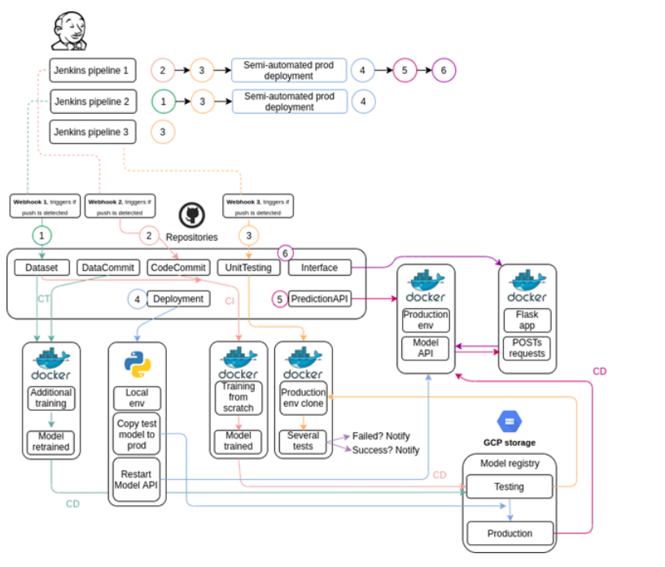
Reference end to end Pipeline CI/CD/CT
As you may notice, it’s composed by 3 major pipelines orchestrated by Jenkins (the default and most popular tool for CI/CD pipelines management), 6 automated tasks and the model registry (a directory for testing and another one for production):
I f Jenkins detects a push in the Code Commit repository (which would mean that a developer modified something in the model code), it will initiate a training from scratch using the code allocated in it (Continuous Integration) and the dataset available in the Dataset repository. The training would be performed on a Docker container and at the end, if the model reaches a predefined accuracy, would be saved in the model testing registry (Continuous Delivery). This unit will be tested in a clone of the production environment using the code allocated in the Unit Testing and if all stages are passed, the success will be notified to the product owner via email which will need to execute the Semi-automated production deployment (Continuous Deployment), which is a script that copies the model from the testing directory to the production one and initiates the prediction service (Model API).
If Jenkins detects a push in the Dataset repository (meaning that more data has been gathered), the pipeline would check if a model exists already in the production registry. If it does, Jenkins would initiate the retraining of this model (Continuous Training) and would save it in the model testing directory (Continuous Delivery). If no model is detected in the production directory then the one available in the testing directory would be retrained. To do this, Jenkins would take the retraining code allocated at the DataCommit repository and the dataset at the Dataset one. Next, the unit testing would be performed (with the code available in the UnitTesting repository) and if everything goes well, the results would be notified to the product owner via email, which will need to execute the Semi-automated production deployment workflow (Continuous Deployment).
Finally, if any change is made in the UnitTesting repository (meaning that more tests have been added to the unit testing step), the model from the registry will be loaded and tested. If everything goes well, it will be saved again in the registry.
Source : https://www.codeproject.com/Articles/5301644/Automatic-Training-Testing-and-Deployment-of-AI-Us
Note : there are 11 series of this blog please search “MLOps” in search box

Slide 7
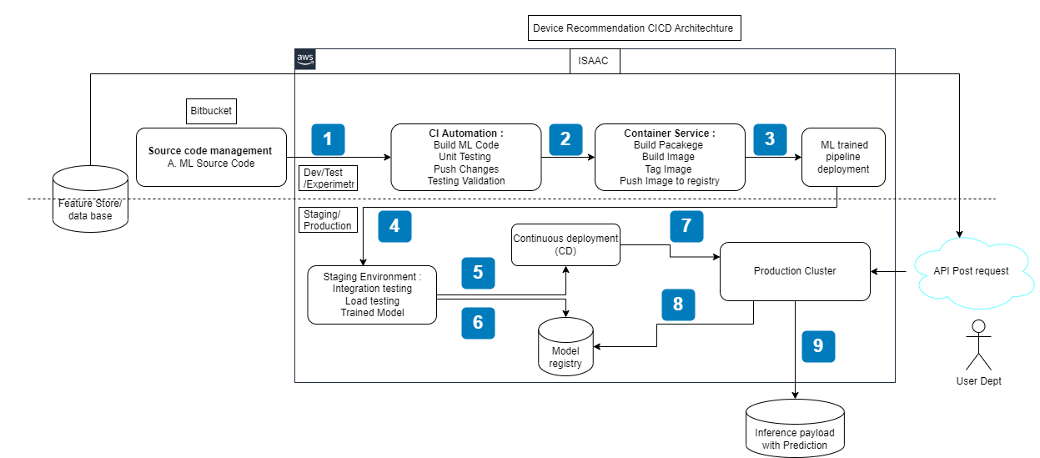
Planned Architecture

Slide 8
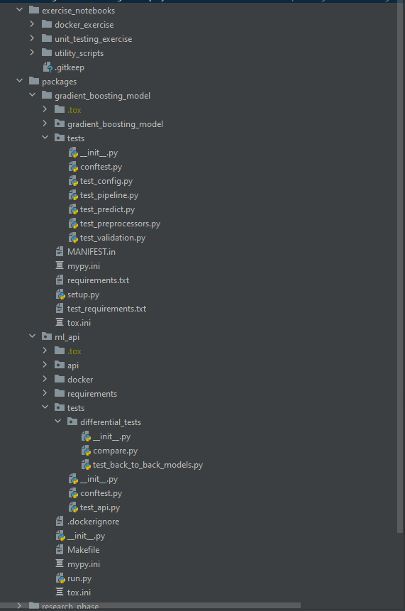
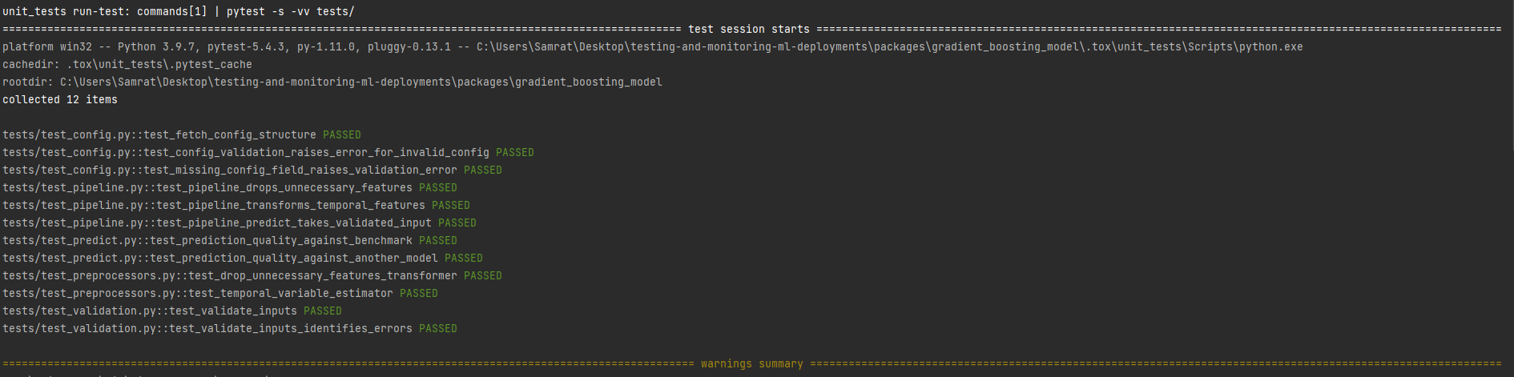
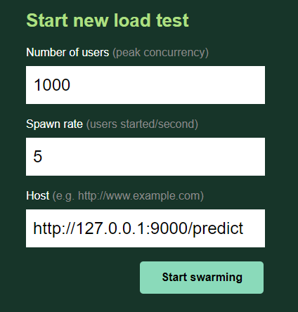
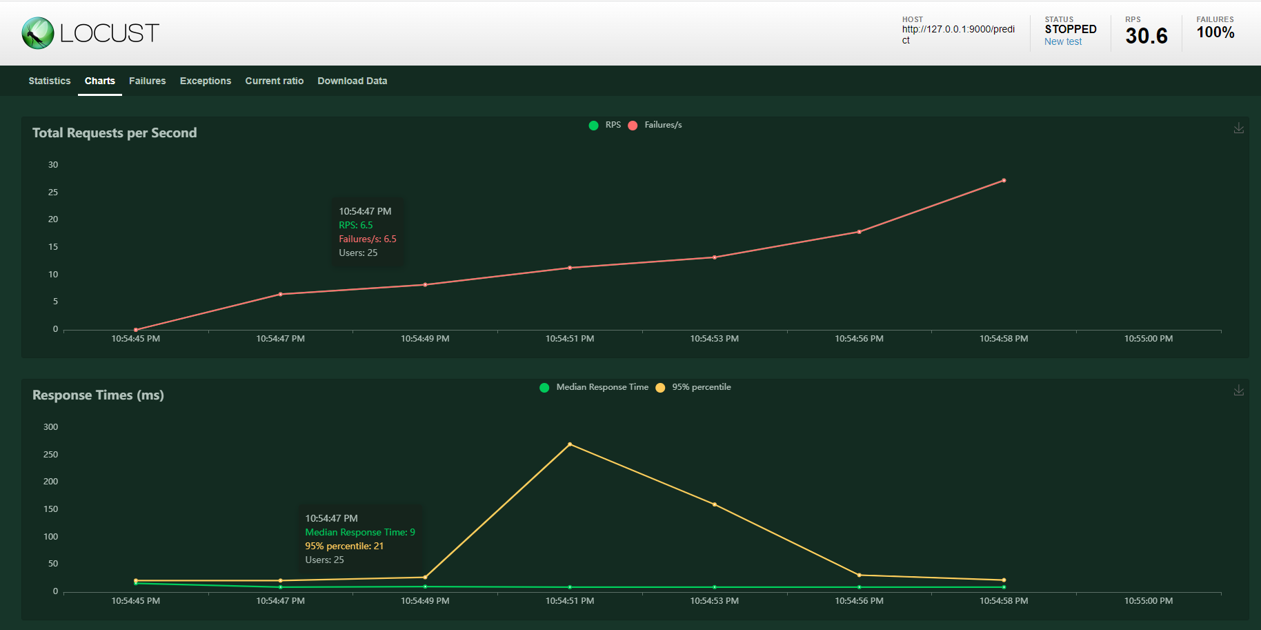
Overview of Unit Testing , Integration testing , Differential testing ,Load testing
We can use tox (private env) ,pytest for all type of test .(pipeline test , prediction test, reprocessing test, validation test , api test and differential test).
Shared reference for gitrepo and course if needed .
Load and Performance Testing using Locust / or We can also us one with Seldon
https://github.com/trainindata/testing-and-monitoring-ml-deployments
https://www.udemy.com/course/testing-and-monitoring-machine-learning-model-deployments
Reference : https://www.youtube.com/watch?v=wZUkb3JJuvA&t=512s

Slide 9
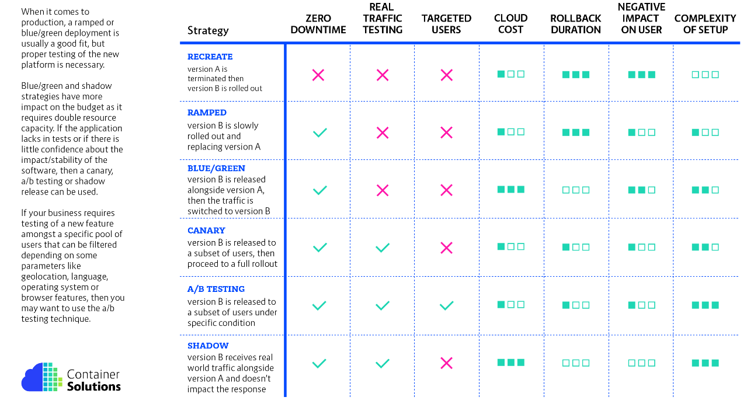
Deployment Strategies

Slide 10
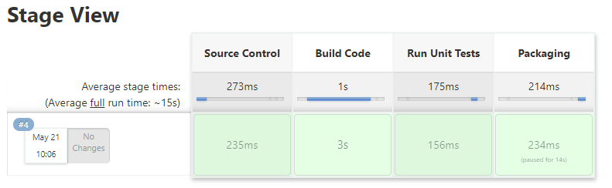
Reference Jenkins CI/CD/ pipeline if model not deployed on ISAAC
pipeline {
agent any
environment {
PROJECT_ID = ‘ml ops'
CLUSTER_NAME = 'training-cluster'
LOCATION = 'us-central1-a'
CREDENTIALS_ID = ‘ml ops'
}
stages {
stage('Clone Repository') {
steps {
checkout scm
}
}
stage('test ml_api') {
steps {
dir("packages/ml_api/") {
sh "pip install tox"
sh "tox "
}
}
}
stage('Building and pushing image to GCR') {
steps {
script {
docker.withRegistry('https://gcr.io', 'gcr:mlops') {
app = docker.build(‘ml ops/code-commit:latest')
app.push("latest")
}
}
}
}
stage('Deploying to GKE') {
steps{
step([$class: 'Kubernetes Engine Builder', projectId: env.PROJECT_ID, clusterName: env.CLUSTER_NAME, location: env.LOCATION,
manifestPattern: 'pod.yaml', credentialsId: env.CREDENTIALS_ID, verifyDeployments: true])
}
}
}
}

Slide 11
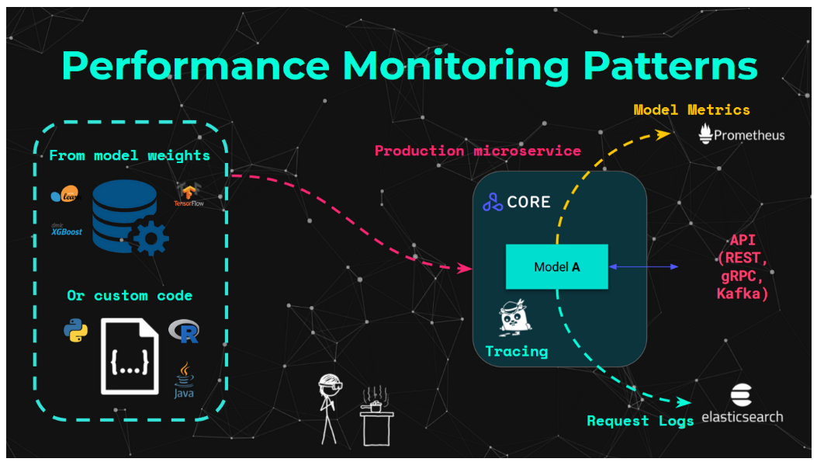
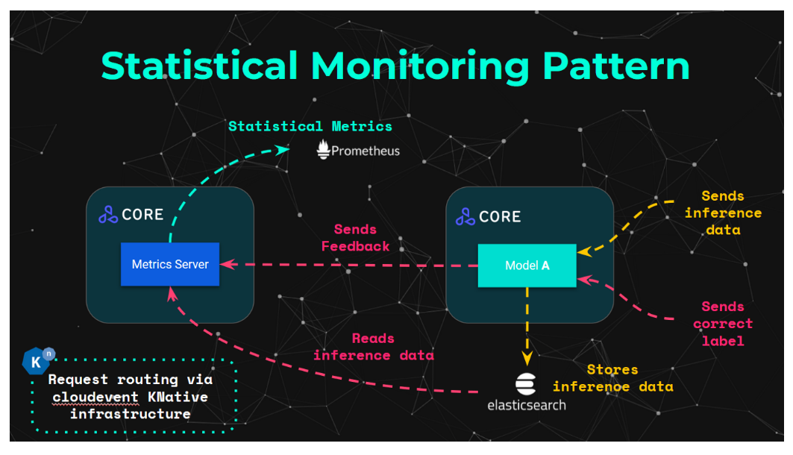
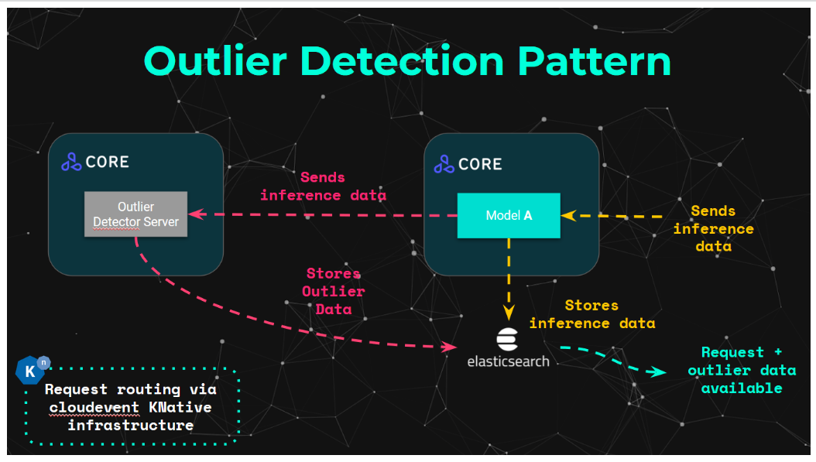
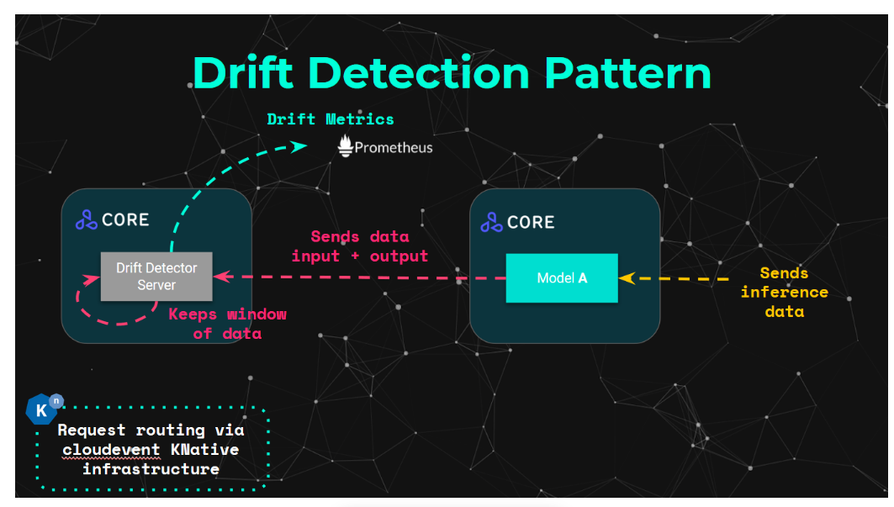
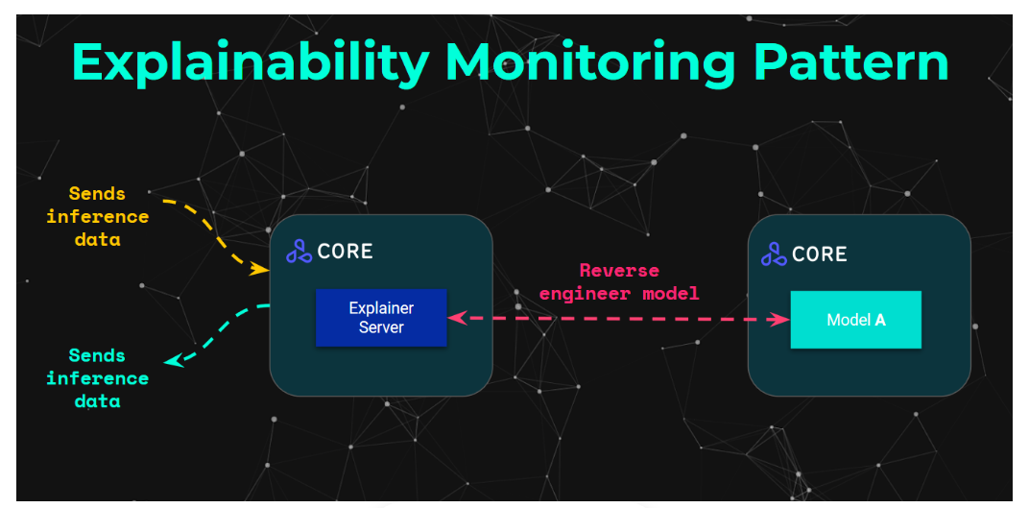
Mlops : CI/CD/CT with ISAAC
ISAAC Platform
(Seldon deploy)
Google level 2
Source : https://towardsdatascience.com/production-machine-learning-monitoring-
outliers-drift-explainers-statistical-performance-d9b1d02ac158

Slide 12
Thank you
Samrat Tidke
stidke@its.jnj.com
samrat.tidke@atos.net

